Slide 1


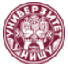
Development of master curricula for natural disasters risk management in Western Balkan countries
Short presentation of the University of Niš
Vesna Lopičić,
Vice-Rector for International Relations
Kick-off meeting, Nis, 15th and 16th December 2015
Project number: 573806-EPP-1-2016-1-RS-EPPKA2-CBHE-JP
"This project has been funded with support from the European Commission. This publication reflects the views only of the author, and the Commission cannot be held responsible for any use which may be made of the information contained therein"

Slide 2
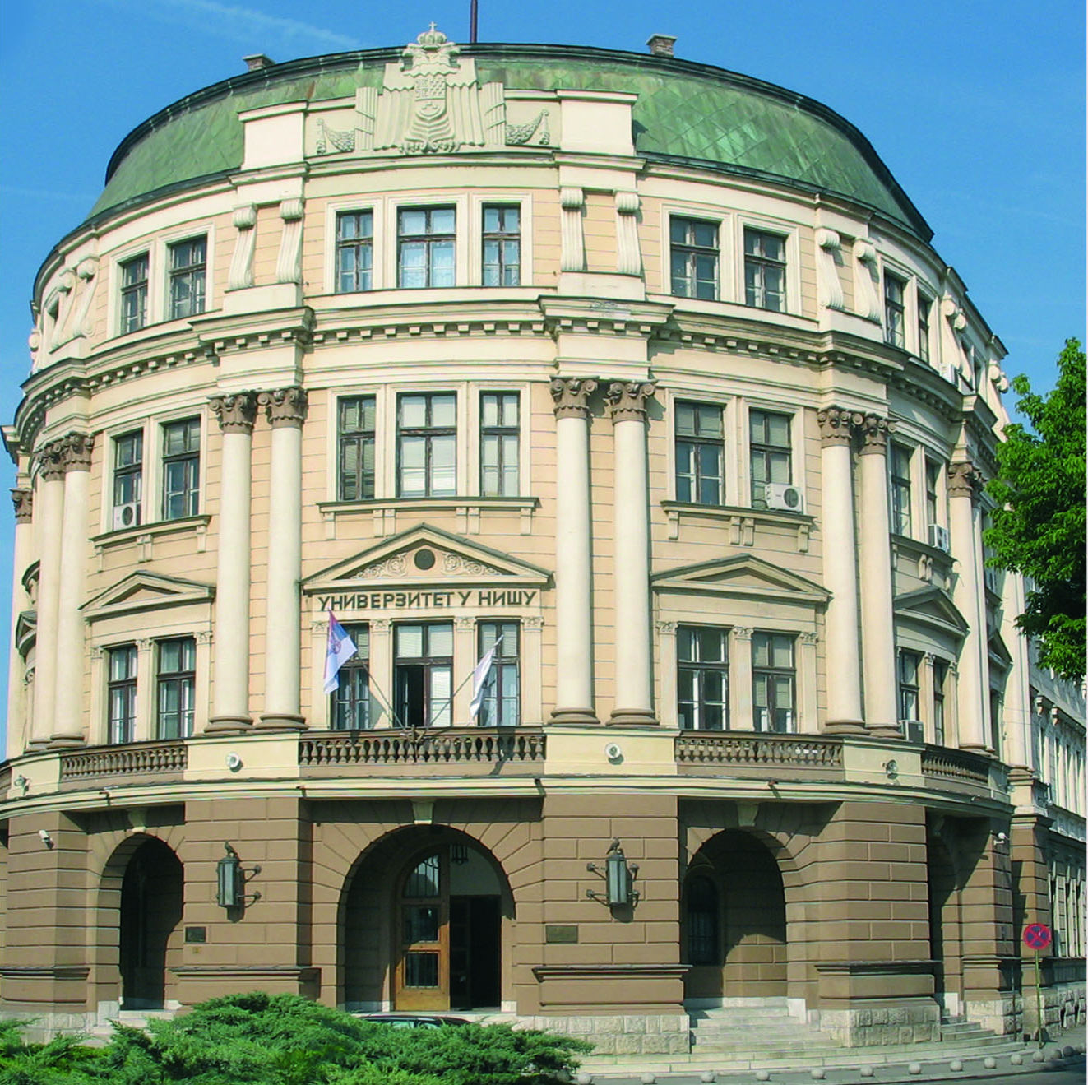
The seat of UNI
Development of master curricula for natural disasters risk management in Western Balkan countries
BANOVINA:
◦ built in 1889
◦ 26th July 1914 –
16th October 1915
◦ the seat of UNI since 1966

Slide 3
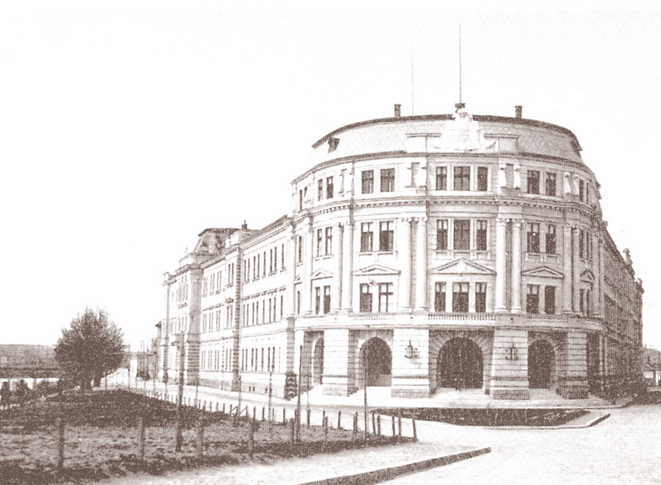
In the beginning
Development of master curricula for natural disasters risk management in Western Balkan countries
.
.

Slide 4
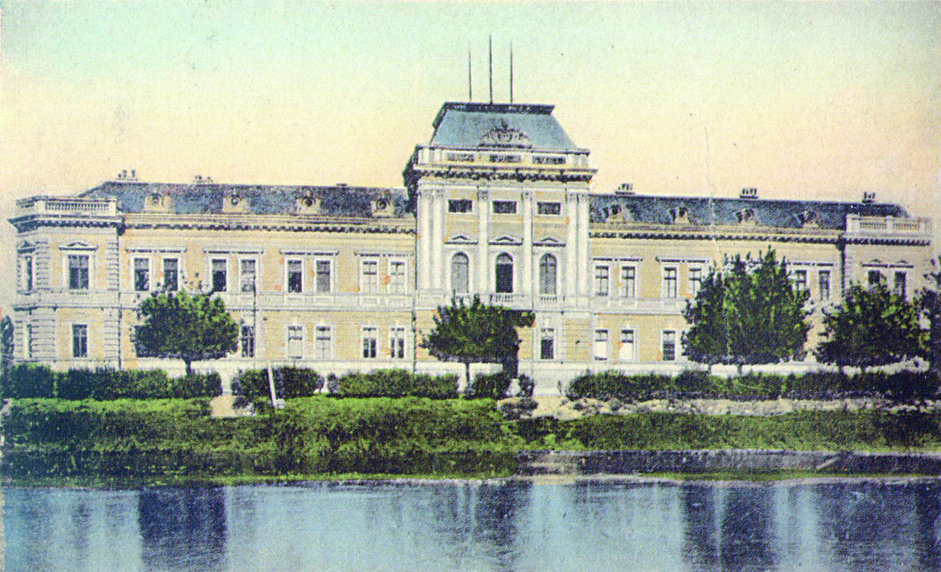
First half of 20th century
Development of master curricula for natural disasters risk management in Western Balkan countries
.

Slide 5

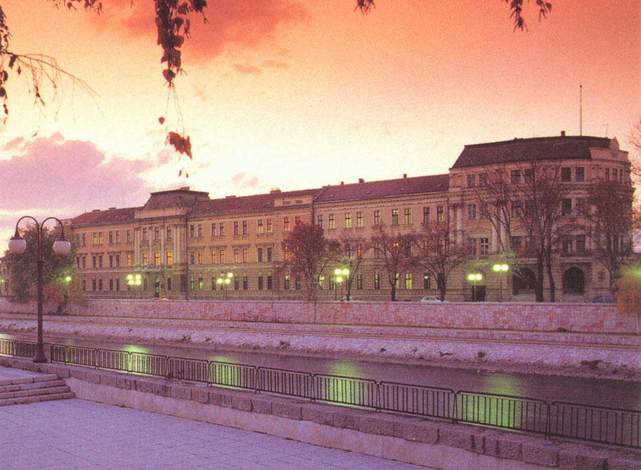
Now
Development of master curricula for natural disasters risk management in Western Balkan countries
.

Slide 6

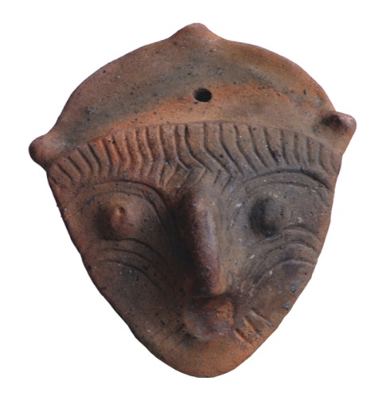
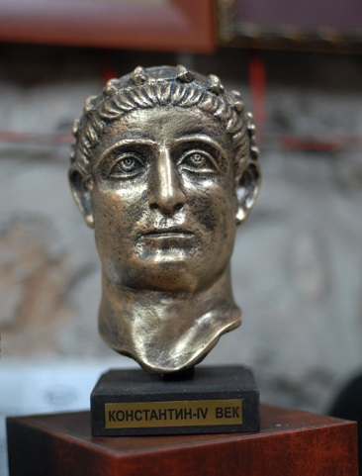
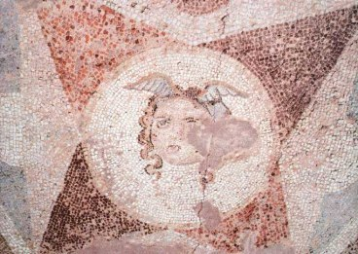
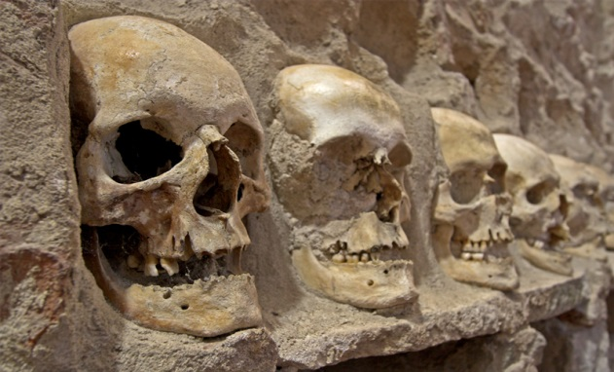
Pre-historic, Roman and Turkish Niš
Development of master curricula for natural disasters risk management in Western Balkan countries

Slide 7
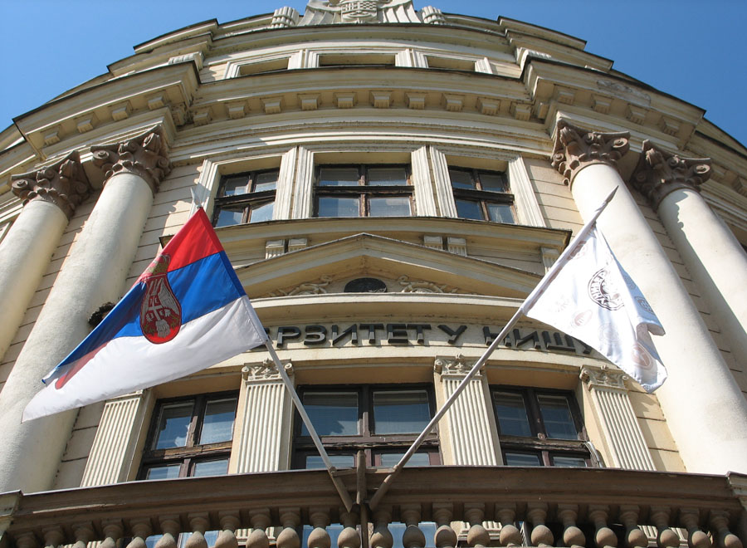
UNIVERSITY OF NIŠ in 1965
Development of master curricula for natural disasters risk management in Western Balkan countries
◦ founded June 15th 1965
◦ three faculties
◦ 234 fulltime teaching staff
◦ 10 500 students

Slide 8
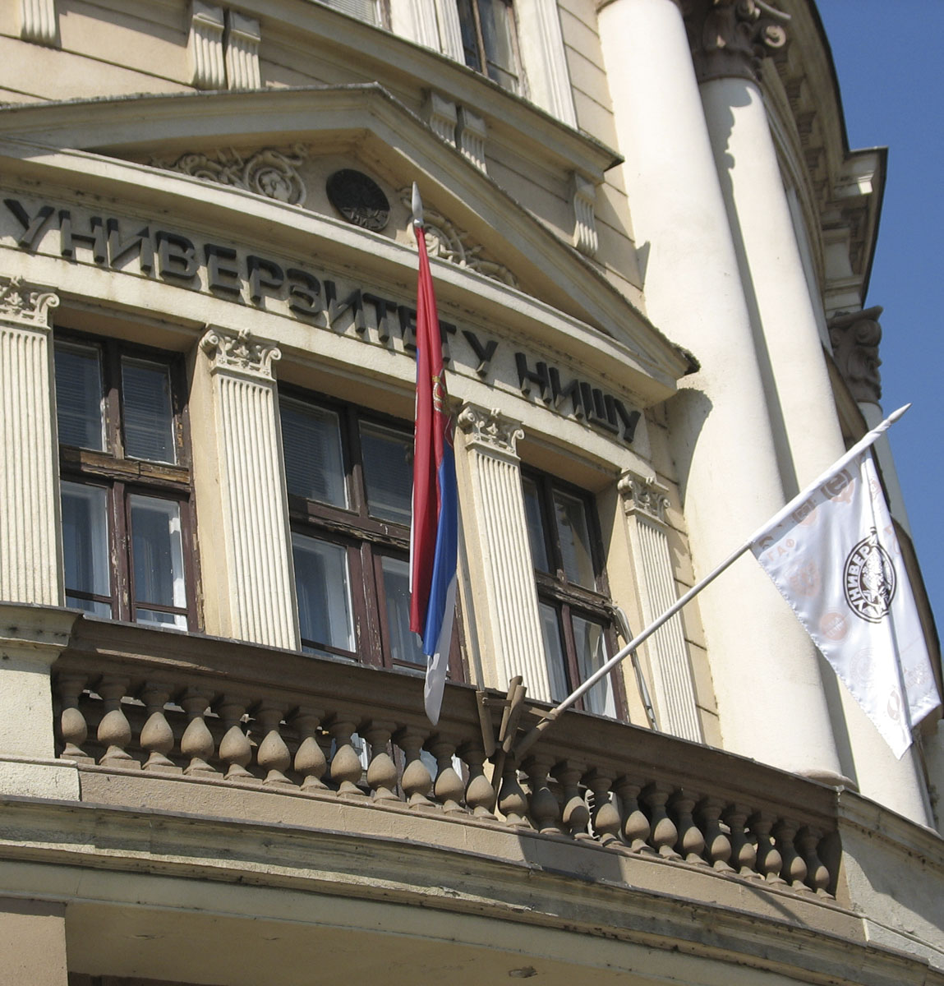
UNIVERSITY OF NIŠ in 2016
Development of master curricula for natural disasters risk management in Western Balkan countries
STATISTICS for 2016/2017
◦ total of 27 884 students
enrolled in all years
◦ 13 faculties
◦ 7 751 freshmen

Slide 9


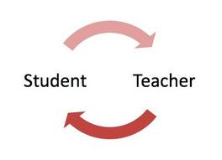
MORE STATISTICS
Development of master curricula for natural disasters risk management in Western Balkan countries
◦ 1694 teaching staff
◦ 138 accredited programmes

Slide 10
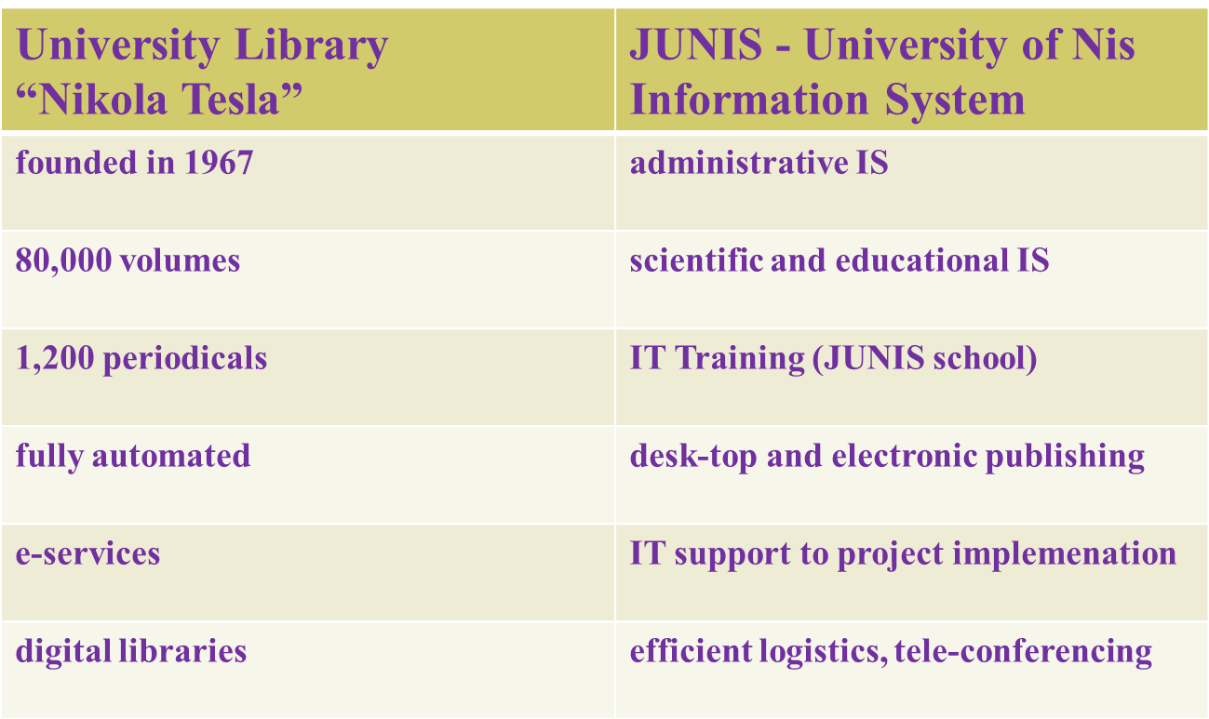
UNIVERSITY OF NIŠ SERVICES
Development of master curricula for natural disasters risk management in Western Balkan countries

Slide 11

INTERNATIONAL PROGRAMMES
Development of master curricula for natural disasters risk management in Western Balkan countries
TEMPUS: 2001
CEEPUS: 2005
FP7: 2007
IPA: 2007
ERASMUS MUNDUS: 2008
MEVLANA: 2013
ERASMUS+: 2015
HORIZON 2020: 2016

Slide 12
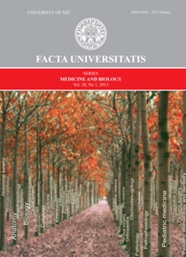

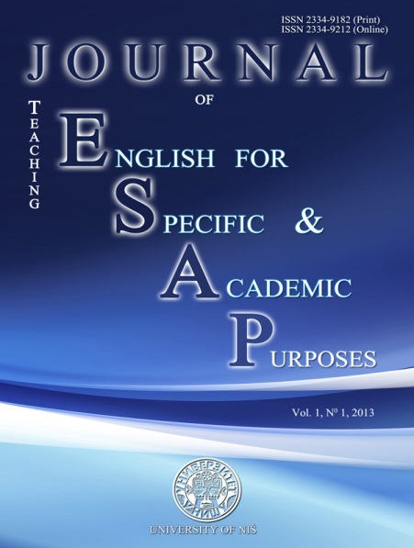
SCIENTIFIC JOURNALS
Development of master curricula for natural disasters risk management in Western Balkan countries
Teme: Journal for Social Sciences: 1977
Facta Universitatis: published in English: 1986 (14 volumes)
Journal of Teaching English for Specific and Academic Purposes: 2013

Slide 13
TEMPUS PROJECTS
Development of master curricula for natural disasters risk management in Western Balkan countries
STRENGTHENING HIGHER EDUCATION FOR SOCIAL POLICY MAKING AND SOCIAL SERVICES DELIVERY (FUSE)
FOSTERING UNIVERSITY SUPPORT SERVICES AND PROCEDURES FOR FULL PARTICIPATION IN THE EUROPEAN HIGHER EDUCATION AREA (SIPUS)

Slide 14
ERASMUS+
Development of master curricula for natural disasters risk management in Western Balkan countries
Enhancement of HE research potential contributing to further growth of the
WB region = RE@WBC
15/10/2015 – 14/10/2018

Slide 15
ERASMUS+
Development of master curricula for natural disasters risk management in Western Balkan countries
Development of master curricula for natural disasters risk management in Western Balkan countries
NatRisk
15/10/2016 – 14/10/2019

Slide 16

Let’s do it together!
Development of master curricula for natural disasters risk management in Western Balkan countries

